Slide 1
Predicting Long-Term Retention for New Users
Randy Khalil, 8tracks
SF-DAT-20

Slide 2
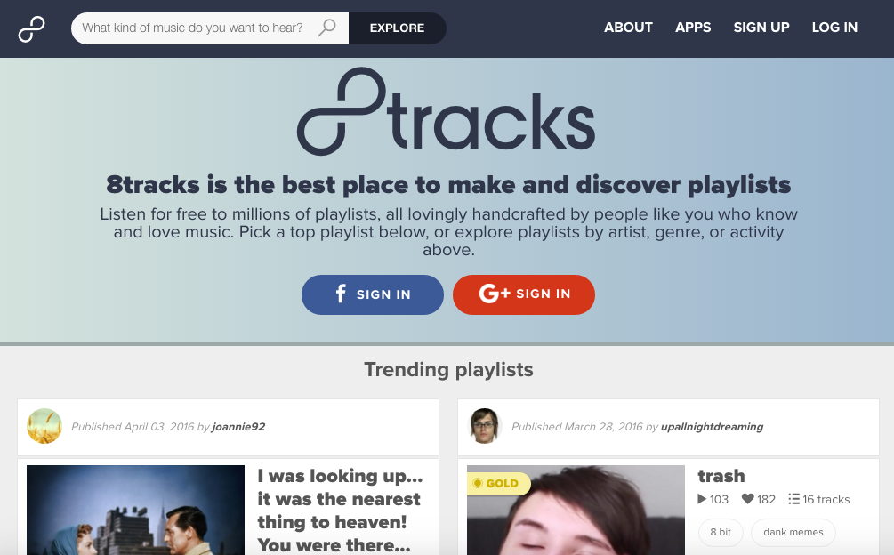
8trac Overview
8tracks is a digital music streaming service built around human-curated playlists.
5 mil. monthly users, approx. 67% US, 33% Canada.
Primary platforms:
iOS app (50% of usage)
Android app (15% of usage)
Desktop website (32% of usage)
Mobile-optimized website (2% of usage)

Slide 3
Summary
Hypothesis: Features from the first 24 hours after the acquisition of new 8tracks users can be used to predict retention several weeks out.
Goal: Create a classifier model which can predict with accuracy and also provide interpretability with regard to the significance of features.

Slide 4
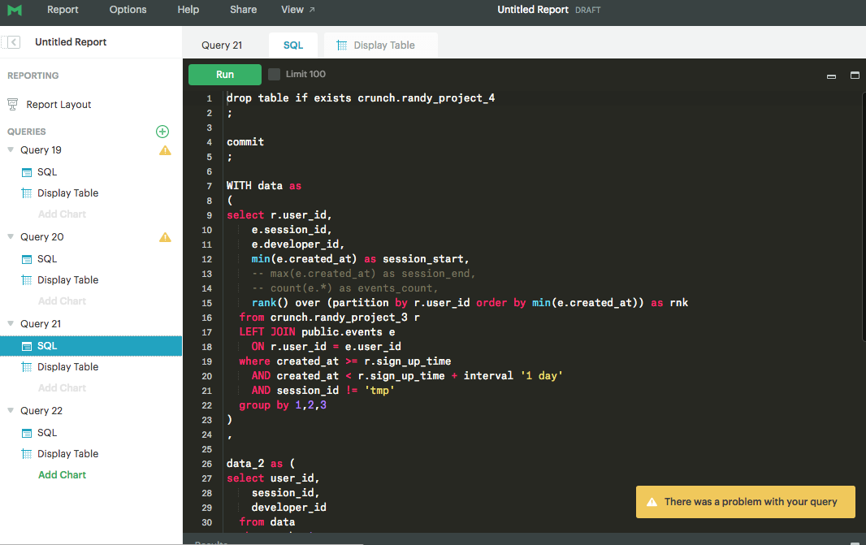
Acquiring Dataset
Biggest challenge: acquiring the data took most of the time.
No single data set existed which contained all of the features I used.
I used Mode analytics to obtain, combine and aggregate data from many different sources in 8tracks’ databases (Redshift).
Final dataset after 22 queries.

Slide 5
Problems with the Data
Many features were inconsistent across platforms (e.g. ”session length” was calculated in a different way for each platform, so I couldn’t use it.)
A “share” was counted on iOS only if it was successful, whereas a ”share” on Android was counted just if the share button was clicked.
For whatever reason, some features that were available for mobile apps were not captured and recorded for the website, like scroll depth, skips, and track favorites.
There was a bug affecting many features which caused an unreasonably high values for some features for the website platform (playlist starts, finishes, likes, etc.). Engineers confirmed that a bug was the likely cause.

Slide 6
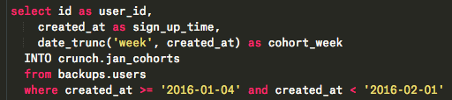
Getting Started
All of the new users included in my analysis were acquired in the 4 weeks between Monday Jan 4, 2016 and Sunday Jan 31, 2016.
I pulled this by querying 8tracks’ users table and filtering by sign-up date. This led to around 105,000 users.

Slide 7
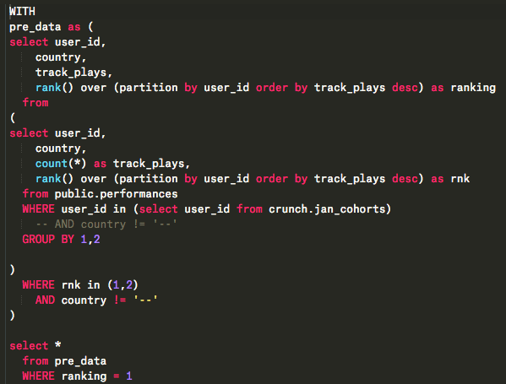
Obtaining Country Attribute
8tracks’ market penetration in Canada is nearly 6x the US rate, and there is less competition there, so I was very interested to see if country had an effect on new user behavior.
Royalty reporting table is the only place where ip and country location is stored.
I matched ip address to country for a given user, ranked by count, and assigned the country with the highest count as the user’s country. In 99.9%+, a user had only 1 country.

Slide 8
Problems with Country Data
However, for a user to show up in this table, they must have listened to at least one track for 30 seconds or longer. As a result from the original 105,000 users I pulled, I was left with only 55,394.
This led to my first learning: almost HALF of newly-acquired users never listen to even a single track for > 30 seconds.
In around 6% of cases, a user didn’t have an ip which could be traced to a country. I removed these users, and as result was left with data for 52,354 users.
I realize that cutting out around half of my data could have huge implications for my findings, but from this point onward, my working dataset will consist of only newly acquired “listeners” who listened to at least 1 track for > 30s, rather than merely “users”.

Slide 9
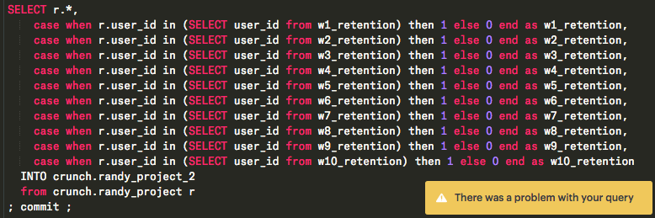
Calculating Retention
I calculated retention for 1-10 weeks beyond the cohort week of the new listeners. For consistency, I define retention as listening to at least 1 track for > 30 seconds.

Slide 10
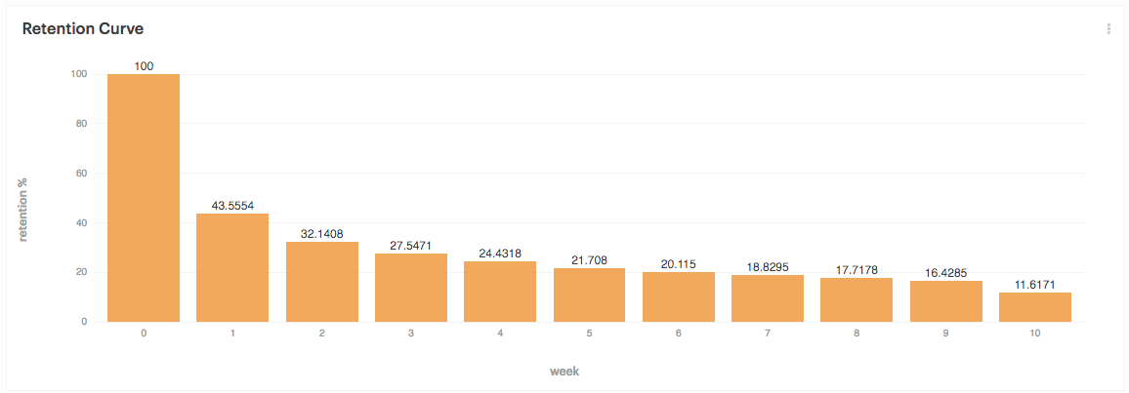
Retention Curve

Slide 11
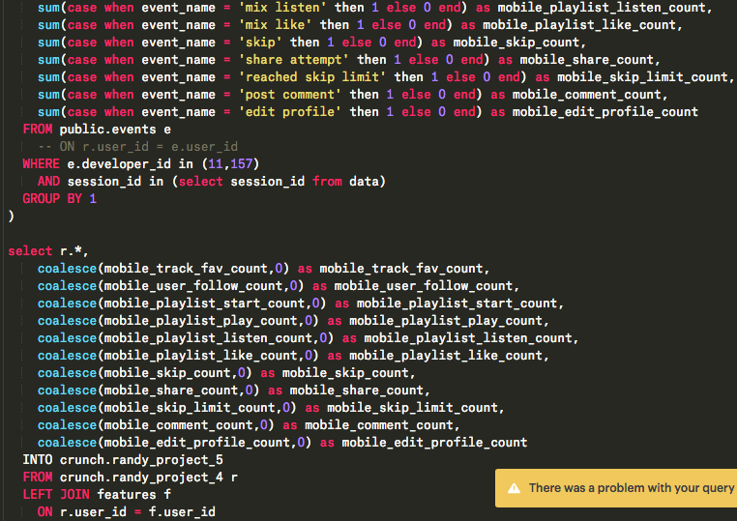
Combining Other Features
Lastly, I joined many other features that were available from an events table.
However, because some features were accurate only for mobile apps, I only included the counts of these features done on a mobile app.

Slide 12
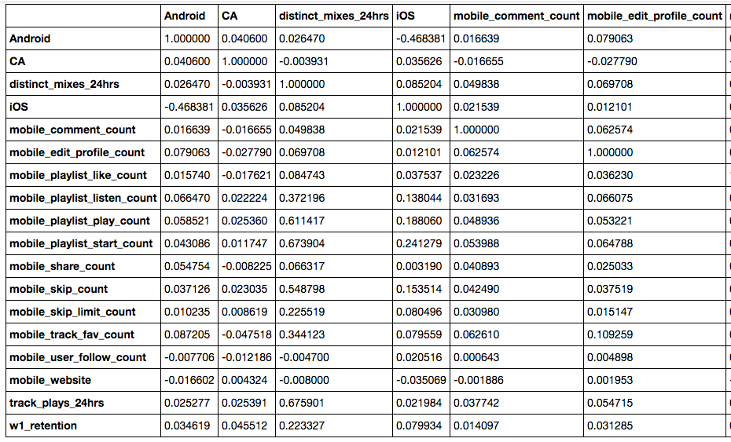
Final Dataset Features
Joined on Android app
Canadian user (base = US)
# of playlists listened in first 24hrs
Joined on iOS app
# comments in first 24hrs
# profile edits in first 24hrs
# playlist likes in first 24hrs
# playlist completions in first 24hrs
# times reached 4th track in playlist
# playlist starts in first 24hrs
# shares in first 24hrs
# skips in first 24hrs
# times reached skip limit in 24hrs
# track favorites in first 24hrs
# DJs followed in first 24hrs
Joined on mobile website
# tracks played in first 24hrs
Retained in w1

Slide 13
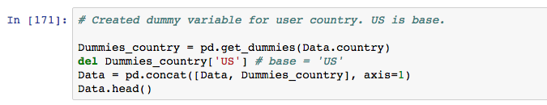
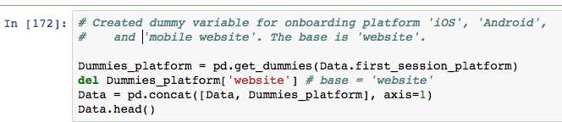
Step 1: Cleaning and Processing
My first goal was to determine which variables were most important for predicting w1 retention, and subsequent weeks if possible.
First I created dummy variables for categorical variables like `platform` and `country`.

Slide 14
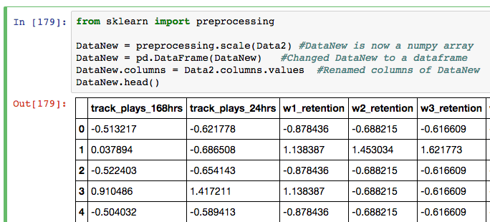
Next I standardized my data

Slide 15
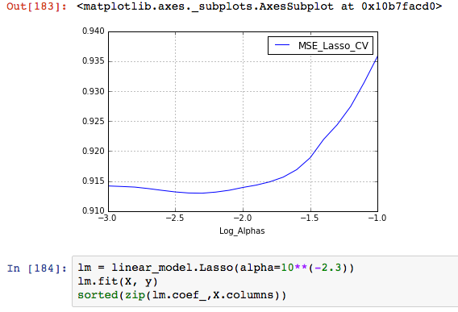
Step 2: Lasso Regression
Now I wanted to use a method such as a Lasso Regression to determine which features were significant, and which were not.
MSE was minimized when lambda = 2.3.

Slide 16
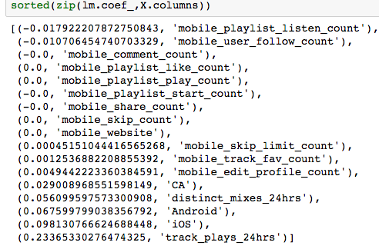
I was able to eliminate 7 features out of 17.
Track plays in the first 24 hours was the most important feature for predicting retention.
The acquisition platform was significant. iOS and Android did better than the base (website).

Slide 17
The number of DJs followed is negatively affects retention.
The number of playlists a user listens to all the way through negatively affects retention (highly correlated with the top feature ‘track_plays_24hrs’).

Slide 18
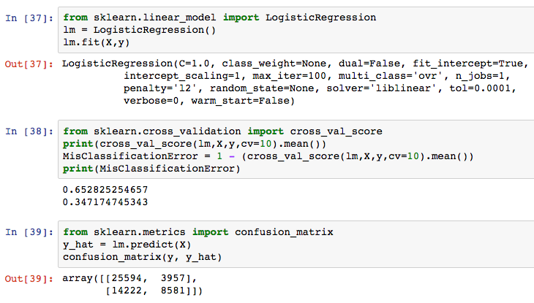
Step 3: Logistic Regression
Ran a logistic regression model with the significant features determined from my Lasso regression earlier.
The misclassification rate was 34.7%, and improvement on w1 retention rate of 43.56%.
This captures 20.0% of error.

Slide 19
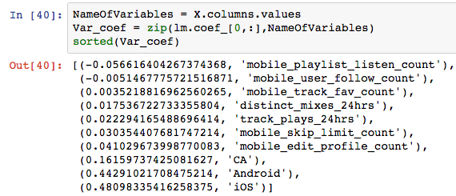
These are the coefficients of my variables.

Slide 20
Interpretation of significant variables.
Joining 8tracks through the iOS app increases the odds of 1-week retention by 48.1% compared to the website. P(w1_retention) increases from 43.6% to 53.3%
Joining 8tracks through the Android app increases the odds of 1-week retention by 44.3% compared to the website. P(w1_retention) increases from 43.6% to 52.7%.
The odds of 1-week retention for new Canadians users is 16.2% higher than US users. P(w1_retention) increases from 43.6% to 47.3%.

Slide 21
Each profile edit a user makes on a mobile app in the first 24-hours after acquisition increases the odds for 1-week retention by 4.1%.
Each distinct playlist a user listens to in the first 24-hours after acquisition increases the odds for 1-week retention by 1.8%.

Slide 22
How Far Into the Future Can We Predict?
Not very far.
At 1 week, a logistic model captures around 20% of error from random classification.
At 2 weeks, a logistic model captures around 3.5% of error from random classification.
At 3 weeks and beyond, a logistic model does no better than random classification.

Slide 23
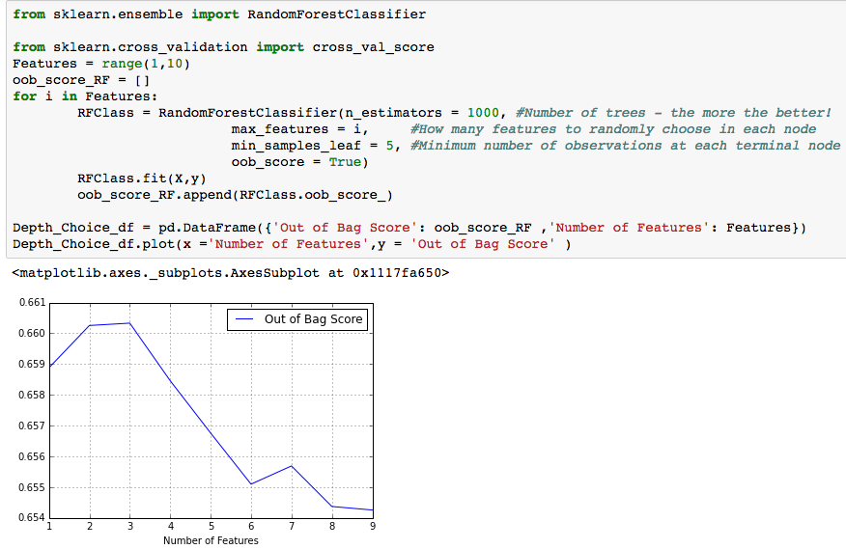
How does Random Forest compare?
Although I was interested in interpretability, I ran a random forest model to see if I could improve prediction.
I found that the optimal # of features to minimize out-of-bag error was 2.

Slide 24
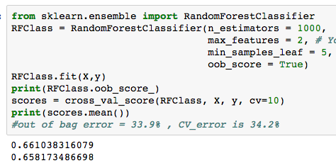
The out-of-bag error was 33.9%, and cross validation error 34.2%.
This is only slightly lower than the 34.7% misclassification error from the logistic model.

Slide 25
Next Steps
A better dataset would have been more ideal. There are limits to interpretability of non-uniform data.
Because some features were captured differently across different platforms, and because some features are unique to certain platforms, it could be good to break down my data set by user’s primary platform (iOS, Android, website), and model each separately.
It would be interesting to capture more features and repeat this analysis each week to see if different features affect retention more significantly week 1 into week 2, or week 2 into week 3, etc.

Slide 26
Conclusion
Retention cannot be predicted with high accuracy based on the features of a new users first 24 hours, likely because of shocks and other changes in behavior which cannot be foreseen.
I’ve found that the 5 most important factors that affect 1-week retention for newly acquired users:
The number of tracks a new user listens to in the initial 24 hours.
Whether the user was acquired through the iOS App
Whether the user was acquired through the Android App
The number of distinct playlists a user listens to in the initial 24 hours.
Whether or not the user is Canadian.

